Slide 1
Twitter Followers Network Analysis and Recommendation model
Team 6
Ananya Sajwan – 18BCE1355
CSE3021 - Social Information Networks A1 SLOT
J-Component Review 3

Slide 2
ABSTRACT
Social media data from Twitter, Instagram, Facebook, etc. can be analysed using various social analysis models and techniques to gain insights and recommendations.
The main aim of the project is to use Python and NetworkX to analyse Twitter communities and followers using social network analysis techniques and also provide recommendations for new followers on Twitter based on the Network Analysis.
In the previous Review 2, 80% of the project was completed which includes scraping of Twitter data using the Twitter API and processing it to get analysis graphs using NetworkX and iGraph libraries.
The 3 community detection algorithms were compared - Leading Eigen Vector, Multilevel and Label Propagation in terms of modularity, membership and iGraph plots is also completed.
For Review 3, the recommendations were done by analysing the scraped Twitter data using NetworkX and generating a friendship graph to identify new people to follow.

Slide 3
TECHNOLOGY STACK
01
02
03
04
05
06
Python
Tweepy
Twitter API
The code will be deployed using Python on Jupyter Notebook
Open source Python library for accessing Twitter API
This will be used to get data of people/communities from Twitter directly
Community Detection Algorithms
NetworkX & igraph
Recommendations
Suggest top communities/people to follow based on graph analysis
Eigen Vector, Multilevel & Label propagation and comparing the results
Python libraries for social network analysis using graphs/networks

Slide 4
REVIEW 2 RECAP

Slide 5
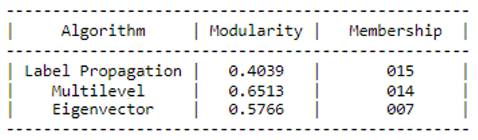
Community Detection Algorithms Comparison

Slide 6
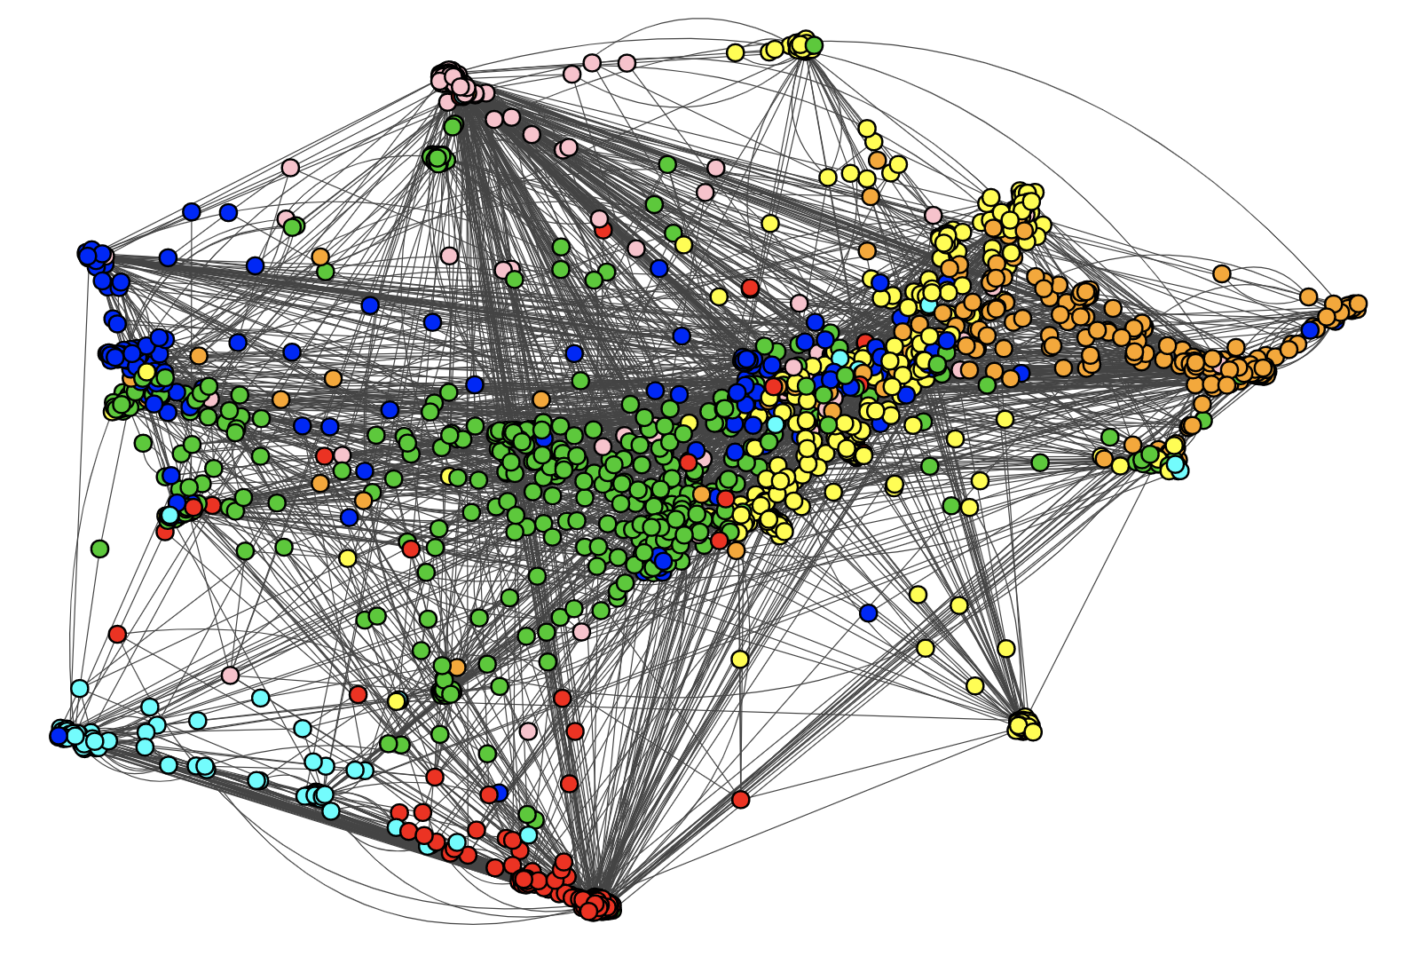
Community Detection using Leading Eigenvector Algorithm

Slide 7
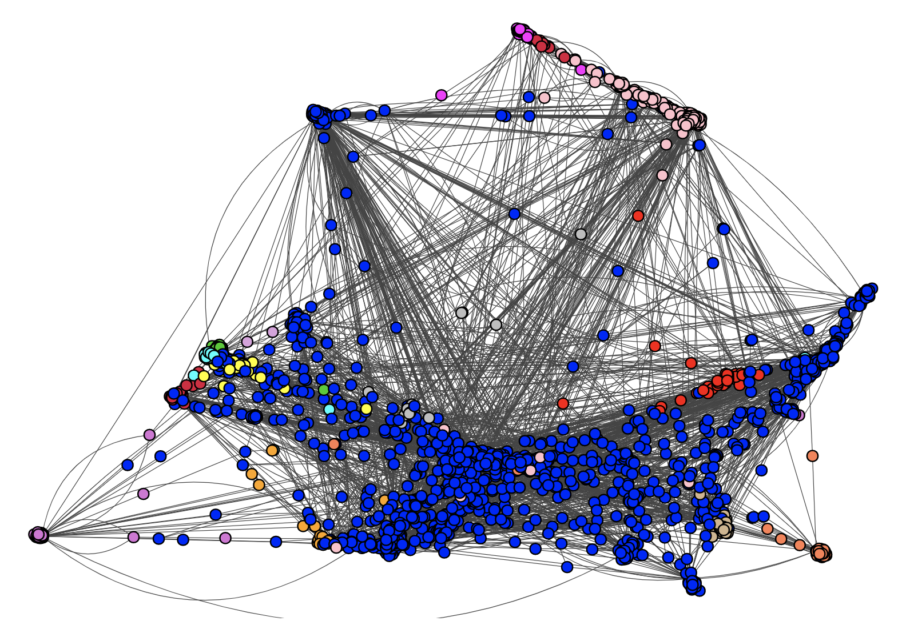
Community Detection using Label Propagation Algorithm

Slide 8
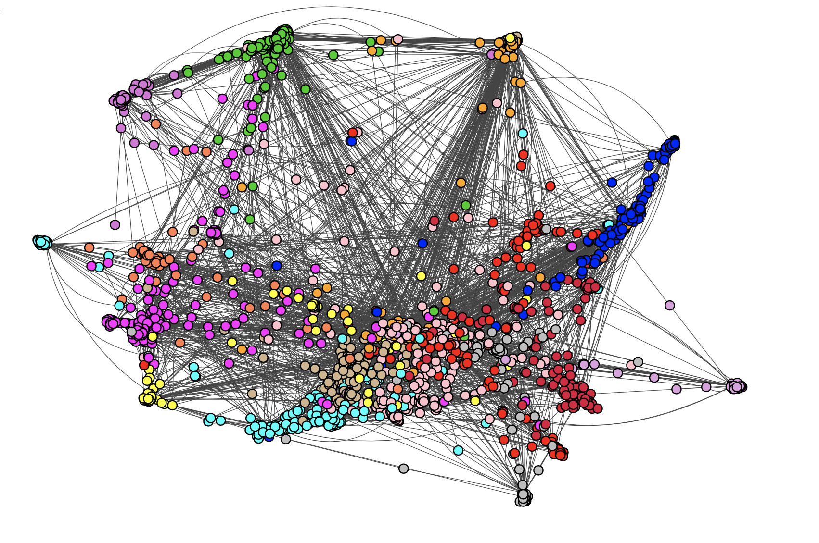
Community Detection Multilevel Algorithm

Slide 9
WORK DONE FOR REVIEW 3

Slide 10
TWITTER API
There are four main objects: Tweets, Entities, Places, and Users.
There are daily restrictions: Calls and changes in the API are restricted by access tokens to protect the platform from abuse. It is based on HTTP (rather than SSL).
The basic services offered to a developer include scraping of publicly available data like Twitter user followers and followings, retrieve tweets, identify hashtags and create bots.
The data for the project is obtained by scraping real time user Twitter data using Tweepy and Twitter API.
Use of the Twitter API is obtained by creating a twitter developer account and obtaining the authorization keys and secret keys (4 in total) for connecting and using the API.
Crawling the data is a long process, and for a small user account it took exactly 2d 22h 43min 17s.
Crawled data saved as a pickle file and can be used for analysis directly.

Slide 11
RECOMMENDATIONS
The data scraped using Twitter API and saved in a pickle file are used to identify follower recommendations.
The followers/followed of the Twitter account are taken into consideration and the friends of these people are used as nodes in the graph.
The people who are already friends with the original account, i.e., ananya_sajwan are filtered out and the remaining are arranged in the order of highest degree to lowest degree.
The nodes with higher degree have more number of mutual connections with the original user and hence are appropriate follower recommendations for the same.
Top 50 recommendations are taken to construct a network graph with the help of NetworkX in Python with 2 shell levels – the second shell level depicts the top 50 follower recommendations and how they are connected to the original user.

Slide 12
RESULTS

Slide 13
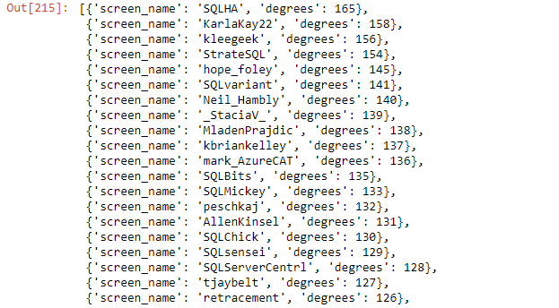
Follower Recommendations – Top 50

Slide 14
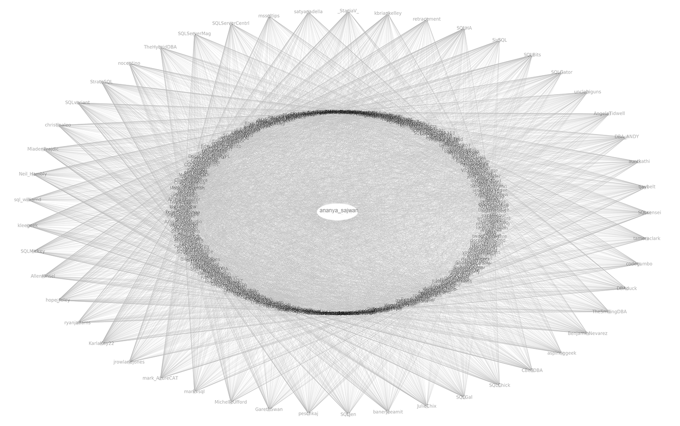
NETWORKX RECOMMENDATION GRAPH

Slide 15
CONCLUSION
The final results can be summarized as:
Twitter data scraping via Tweepy and Twitter API
Twitter data pre-processing and exploratory data analysis.
Community and Followers graph construction.
Comparison of the 3 community detection algorithms selected.
Follower recommendation based on graph analysis using NetworkX.
100% of the project has been successfully completed and the notebooks with results and outputs was analysed.
The novelty of the project includes the real-time web scraping of Twitter data, comparison of the 3 major community detection algorithms and recommendations of new followers based on graph analysis.

Slide 16
Thank You

